Slide 1
Pedestrian Crossing Intention Prediction From Surveillance Videos for Over-the-Horizon Safety Warning
MEMBERS:
S. Pushpa Rani (21BAD019)
R. Vithya Sri (21BAD030)
GUIDE:
Dr. P. Swathika B.Tech, M.E, Ph.d.
Assistant Professor(AI&DS)
Department of Artificial Intelligence and Data Science
Mepco Schlenk Engineering College

Slide 2
Road Crossing Environment - Overview
Get the environment of pedestrian crossing the from two ways
Surveillance camera – For Traffic environment
On - board camera – For Pedestrian features

Slide 3
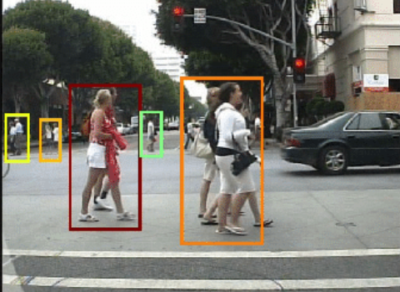
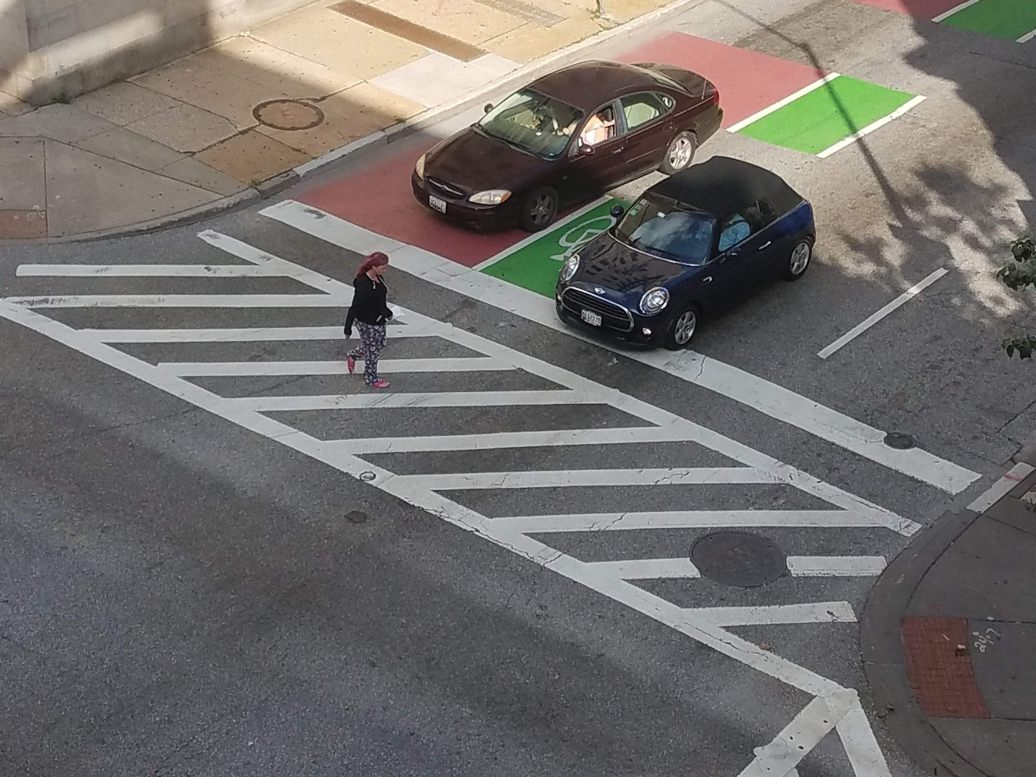
Views of Road Crossing Environment
Onboard camera Surveillance camera

Slide 4
Aim
To develop an advanced pedestrian crossing intention prediction framework that leverages surveillance camera data to enhance pedestrian safety and prevent traffic injuries by extracting the critical features related to both the environment and pedestrian behavior.

Slide 5
Objective
To evaluate the individual contributions of pedestrian-only and environment-only components in predicting crossing intentions.
To predict future pedestrian trajectories and account for sudden changes in speed or direction
To analyze the robustness of the proposed framework across different traffic scenes, including unsignalized sections.

Slide 6
Specification
Hardware Requirements:
Intel (R) Core i9-10900X CPU
NVIDIA RTX 3090 GPU
Software Requirements:
Google Colab (or) Jupyter Notebook
Pytorch 1.8.0
Python 3.8.2

Slide 7
Literature Survey
Title: Action recognition framework in traffic scene for autonomous driving system
Authors: F. Xu, F. Xu, J. Xie, C.-M. Pun, H. Lu, and H. Gao
Published in: IEEE Transactions on Intelligent Transportation Systems
Publication Date: November 2022
Merits
Dynamic adaptive graph convolutional network, which can realize the action recognition of objects based on 3D human pose.
By estimating 3D pose of the pedestrian , it overcomes the traditional 2D methods.
The framework effectively recognizes actions for multiple traffic participants, including traffic police gestures and pedestrian movements.
Demerits
The framework relies on a multi-camera system and requires substantial computational resources, which might limit scalability.
The 3D-HPT dataset only includes a predefined set of actions, potentially overlooking less common but critical behaviors in traffic scenarios. So, it leads to overfitting

Slide 8
Title: Crossing or Not? Context-Based Recognition of Pedestrian Crossing Intention in the Urban Environment
Authors: B. Yang, W. Zhan, P. Wang, C. Chan, Y. Cai, N. Wang
Published in: IEEE Transactions on Intelligent Transportation Systems
Publication Date: June 2022
Merits
Using Resnet3D to automatically detect the starting actions of pedestrians before they cross
The framework is effective even under challenging conditions like occlusions, dim lighting, and large distances, outperforming skeleton-based approaches.
Achieves superior performance
Demerits
The use of ResNet3D and Faster-RCNN increases computational complexity, limiting real-time applicability.
Requires accurate environmental and vehicle state data.

Slide 9
Title: TrouSPINet: Spatio-temporal attention on parallel atrous convolutions and UGRUs for skeletal pedestrian crossing prediction
Authors: J. Gesnouin, S. Pechberti, B. Stanciulcscu, and F. Moutarde
Published in: Proceedings of the 16th IEEE International Conference on Automatic Face and Gesture Recognition (FG)
Publication Date: December 2021
Merits
The proposed approach uses a multi-branch architecture that combines spatio-temporal features extracted through 2D convolutions and self-attention, as well as Euclidean pairwise distances encoded , allowing it to capture features for pedestrian action patterns at multiple temporal resolutions.
Demerits
TrouSPI-Net relies on an additional network to compute pedestrian body poses, which may add complexity and computational overhead to the overall system.
Finetuning gives more optimized results.

Slide 10
Title: Visual reasoning using graph convolutional networks for predicting pedestrian crossing intention
Authors: T. Chen, R. Tian, and Z. Ding,
Published in: Proceedings of the IEEE/CVF International Conference on Computer Vision Workshops (ICCVW)
Publication Date: October 2021
Merits
It extracts the visual appearance of all objects in a scene.
Uses GCN autoencoders with LSTM to encode the relationship between pedestrian and other objects in the scene.
It significantly enhances prediction accuracy for pedestrians with no crossing intention.
The framework integrates pedestrian and object visual features .SO, achieves a balanced accuracy (0.79)
Demerits
The model relies heavily on precise annotations of pedestrian bounding boxes and pose estimations, which may not always be feasible in real-world scenarios.
Higher computational process.

Slide 11
Title: Benchmark for evaluating pedestrian action prediction
Authors: I. Kotseruba, A. Rasouli, and J. K. Tsotsos
Published in: Proceedings of IEEE Winter Conference.
Publication Date: January 2021
Merits
The proposed PCPA model effectively combines visual and non-visual features, such as bounding boxes, poses, ego-vehicle speed, and local context.
The model incorporates attention mechanisms, including temporal attention and modality attention, which enable the model to focus on the most relevant features and weigh their importance, leading to improved performance and robustness.
Demerits
The model's use of multiple branches, including 3D convolutional and RNN branches, as well as attention mechanisms, may increase computational complexity and require significant resources

Slide 12
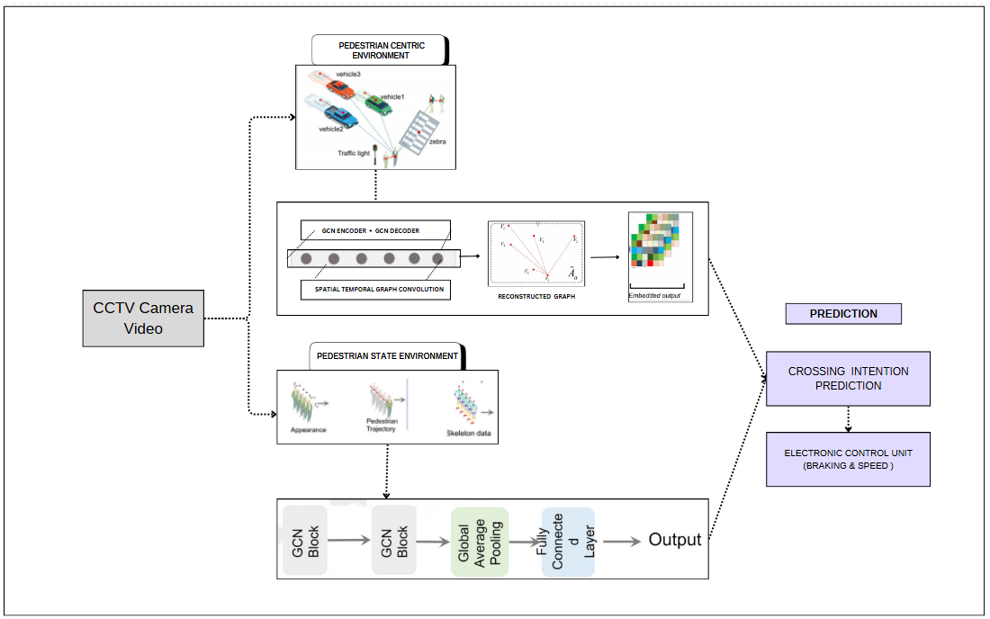
System Design

Slide 13
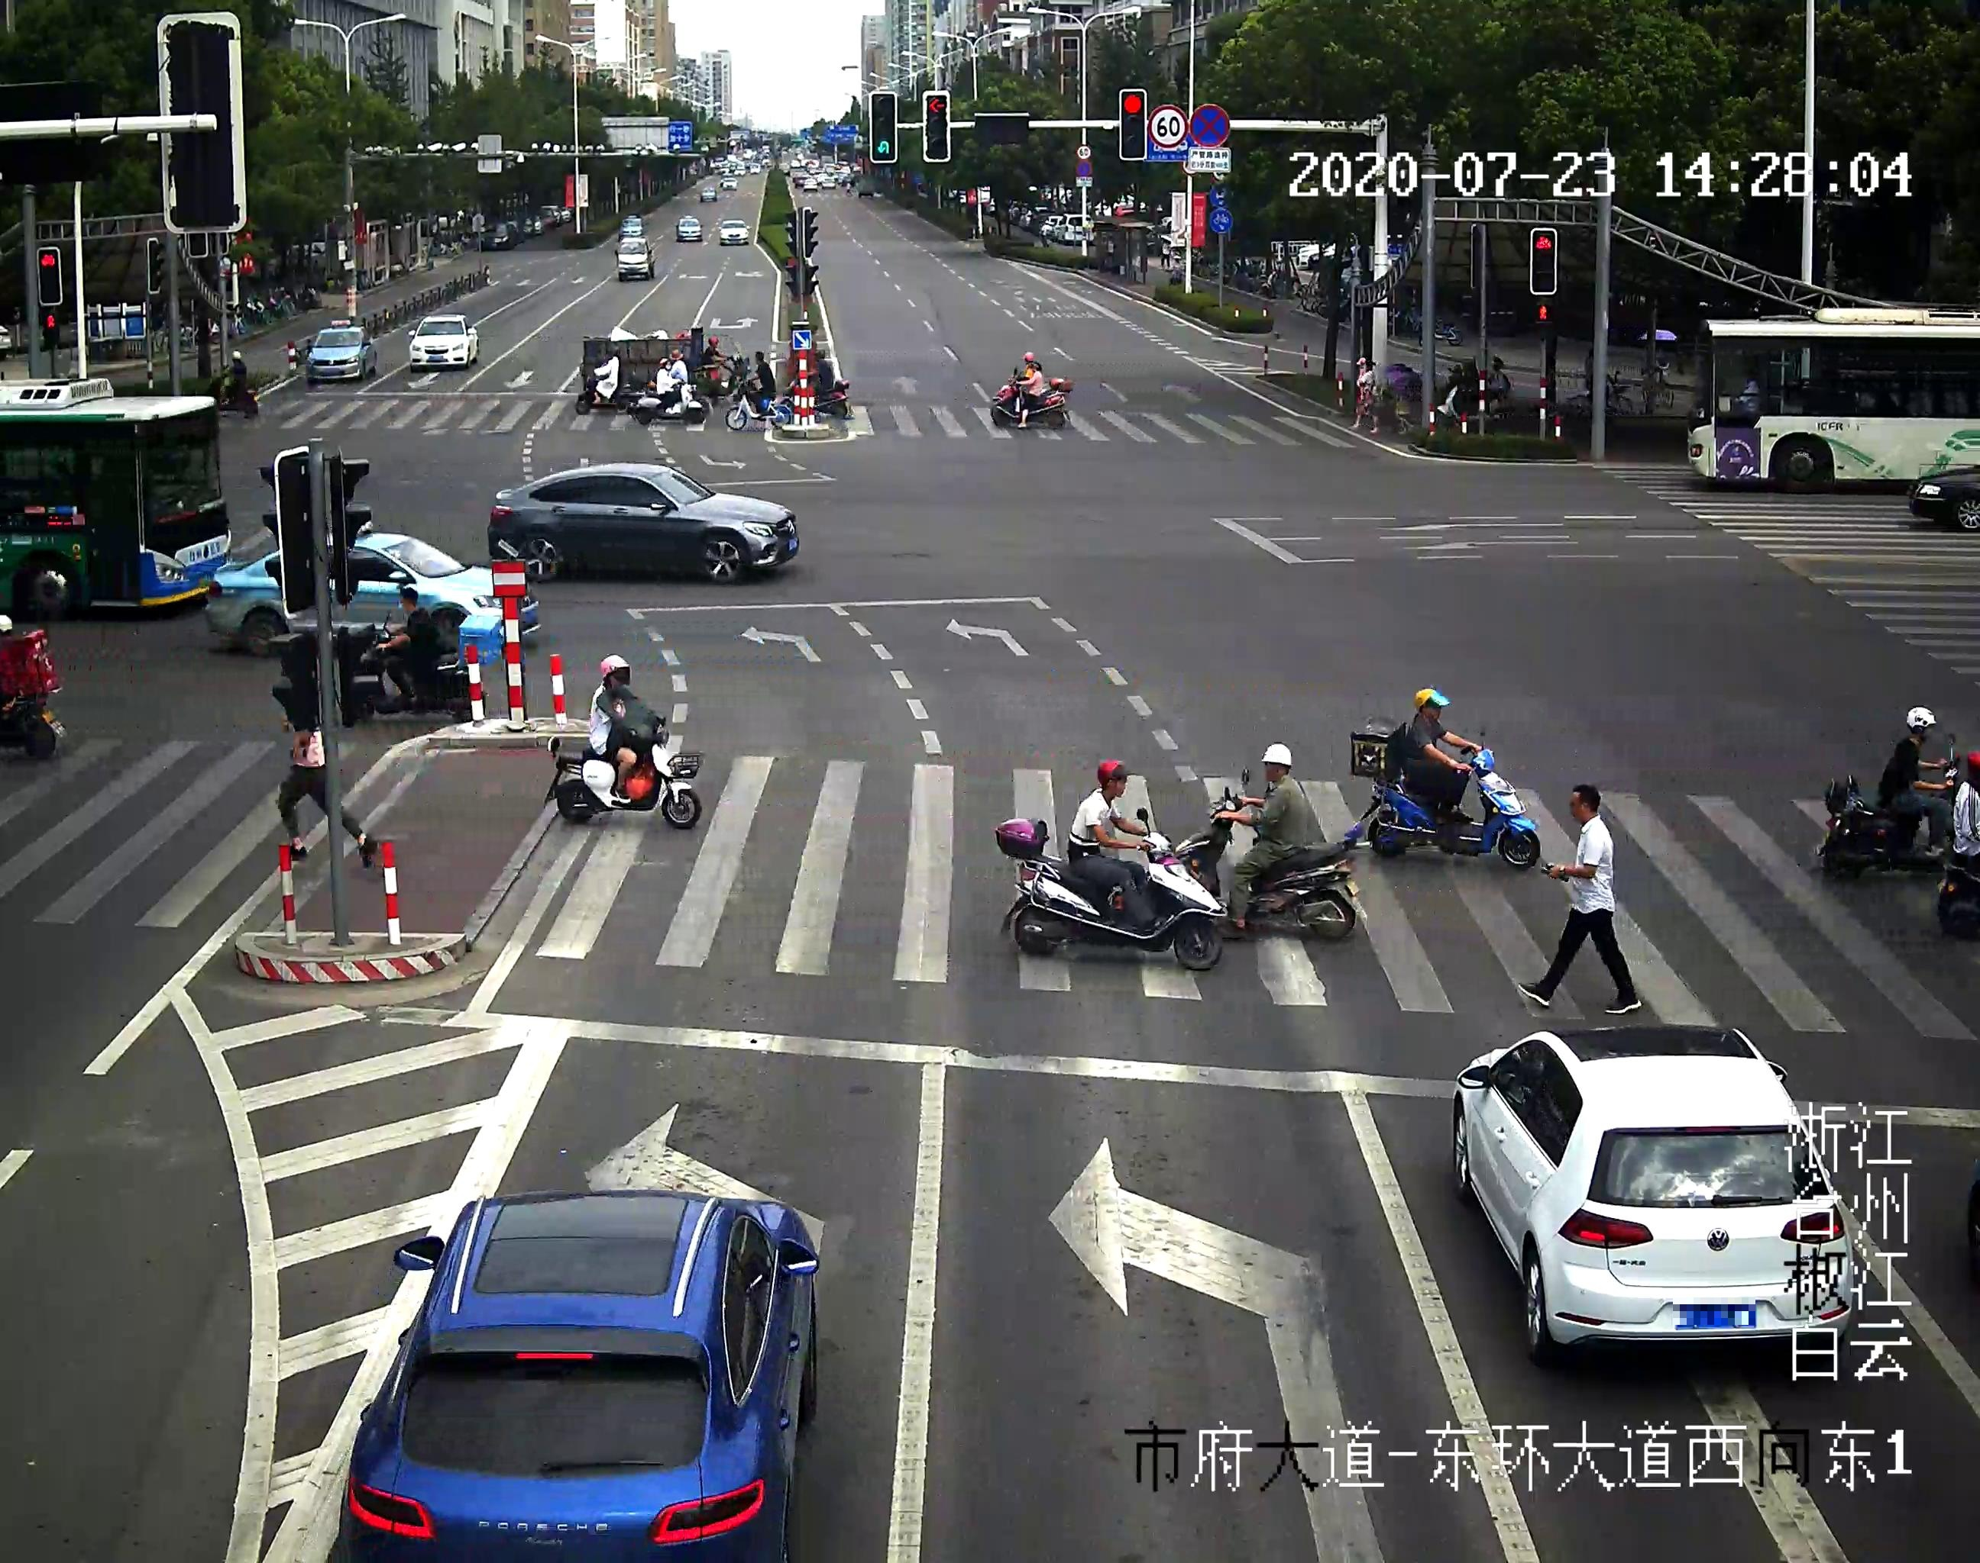
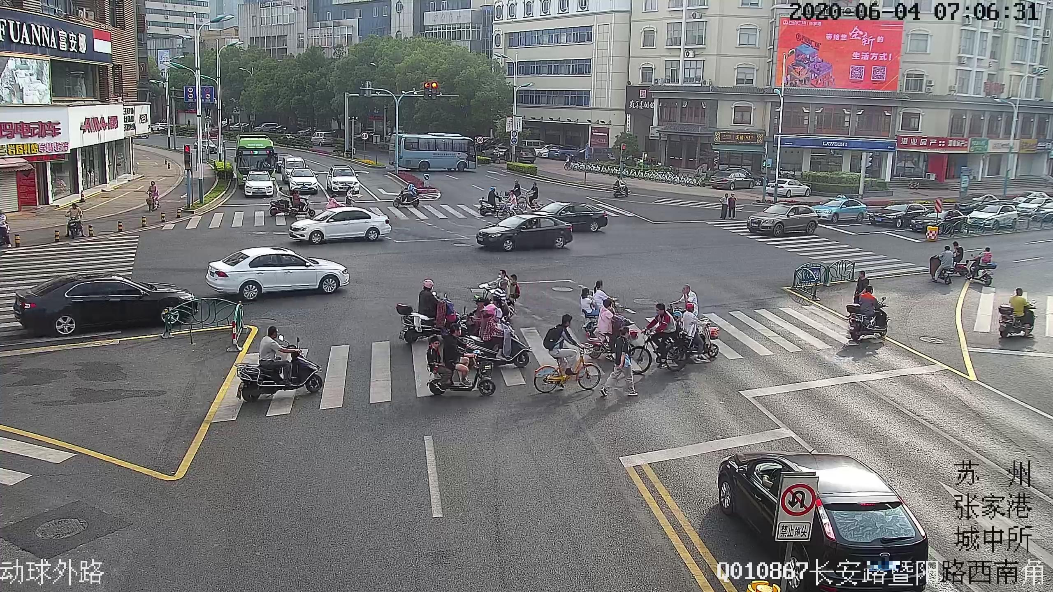
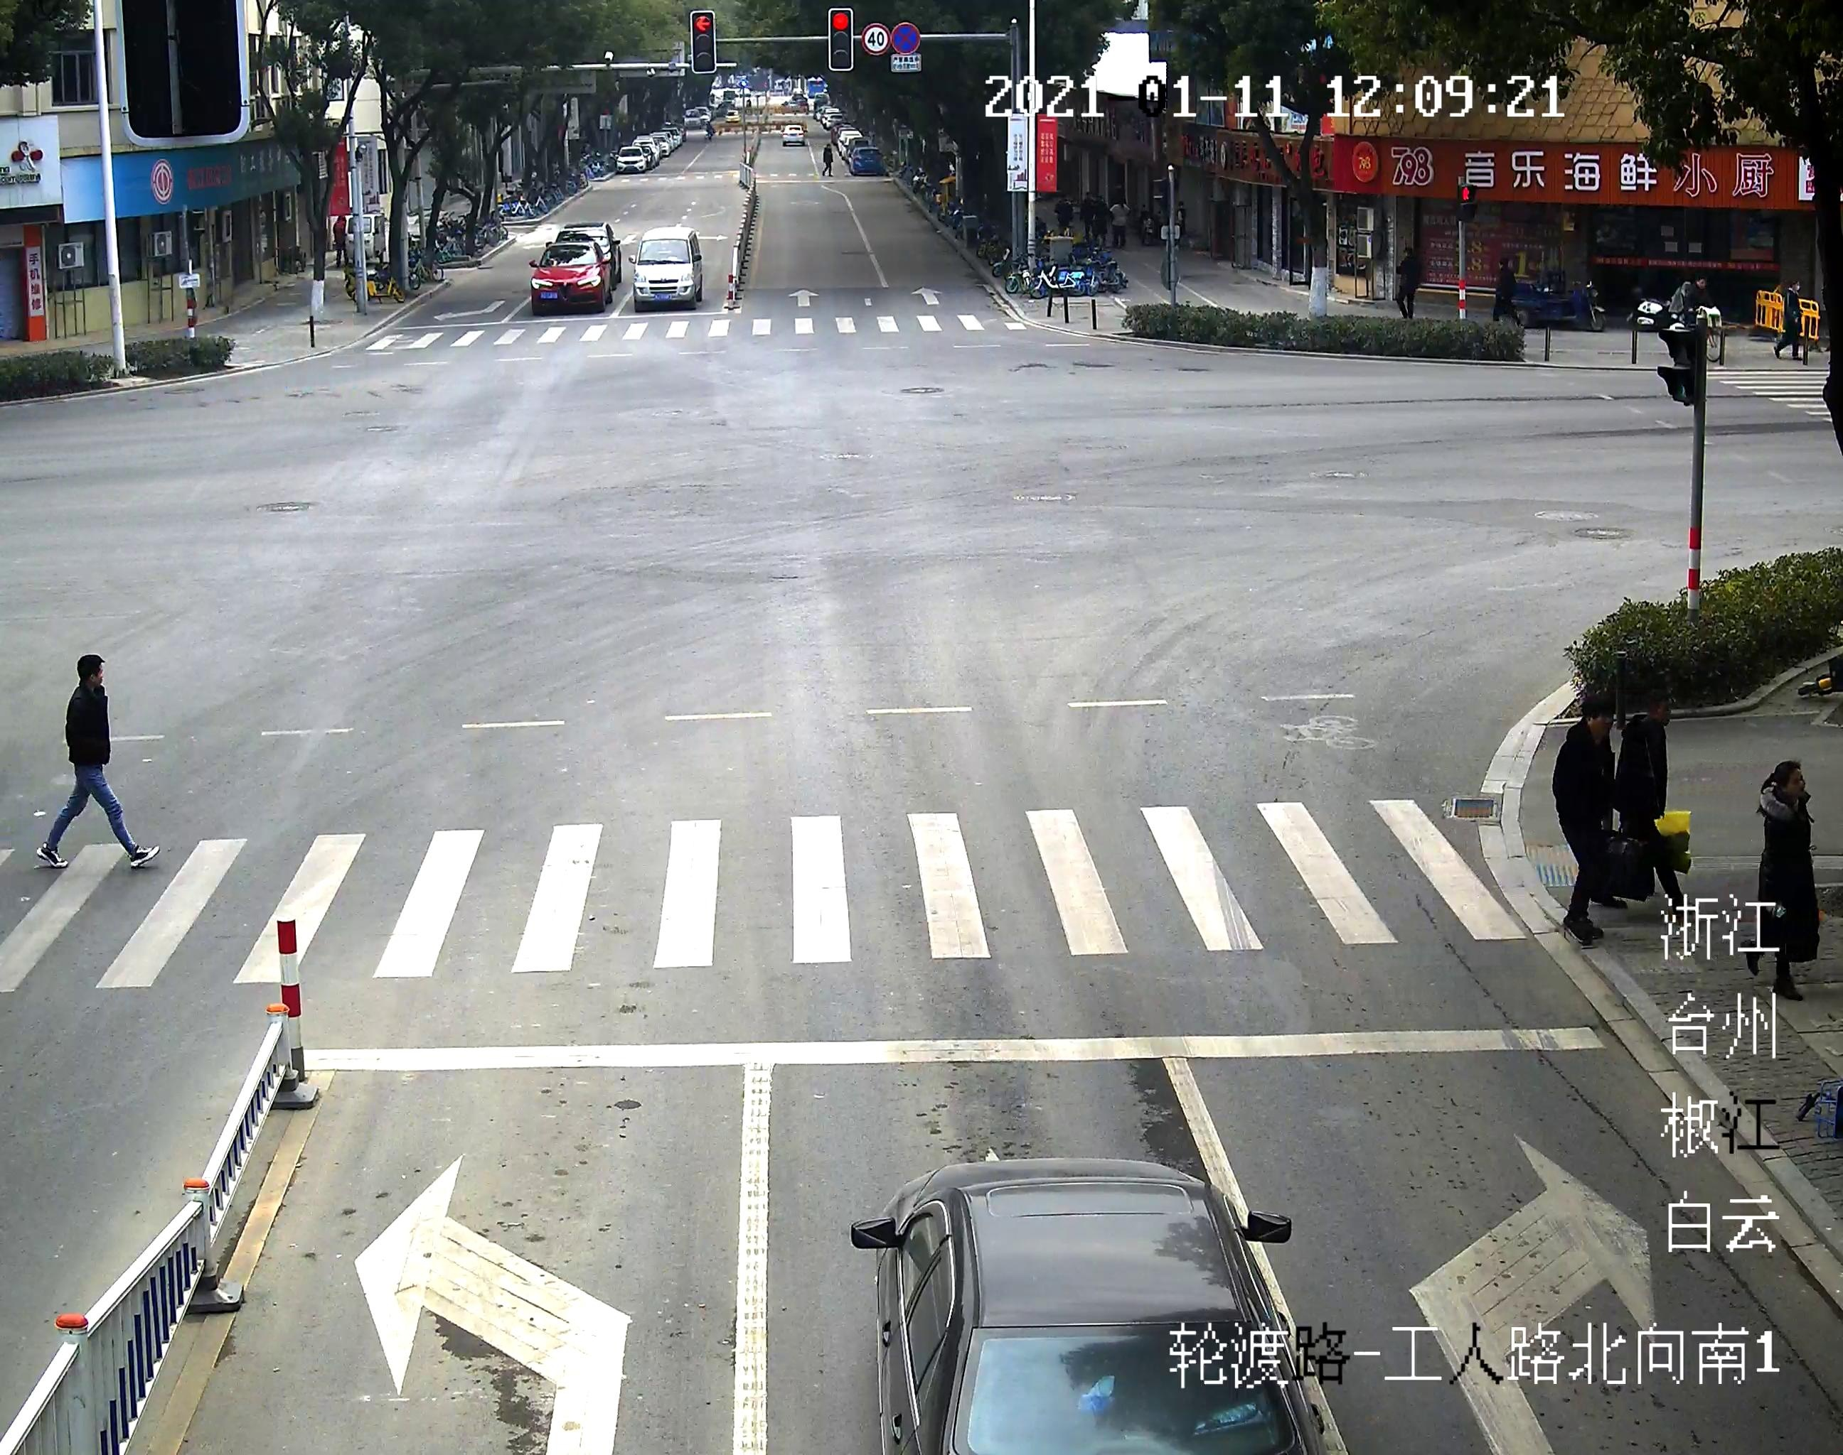
Dataset Description
SEU_PML Dataset – For GCN
SEU_PML Dataset is a large and detailed dataset for monitoring-based traffic participants detection, jointly proposed by Southeast University and Purple Mountain Laboratories.
Total Images - 6,588
Total size – 5 GB

Slide 14
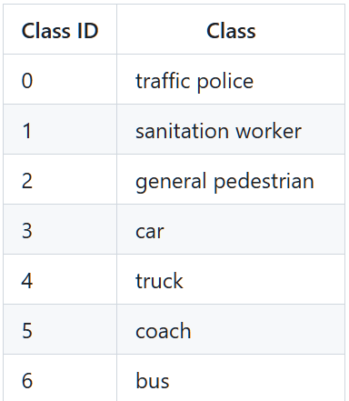
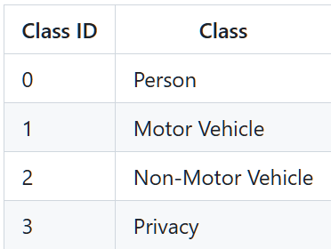
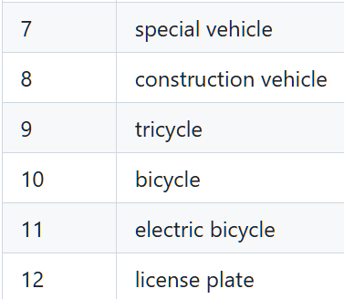
Super Categories
Sub categories

Slide 15
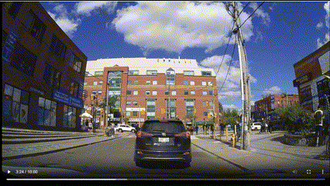
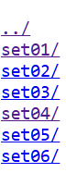
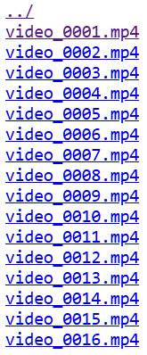
Dataset Description
PIE Dataset – For ST - GCN
PIE is a dataset for studying pedestrian behavior in traffic.
It contains over 6 hours of footage recorded in typical traffic scenes with on-board camera.
Total size – approx. 72GB

Slide 16
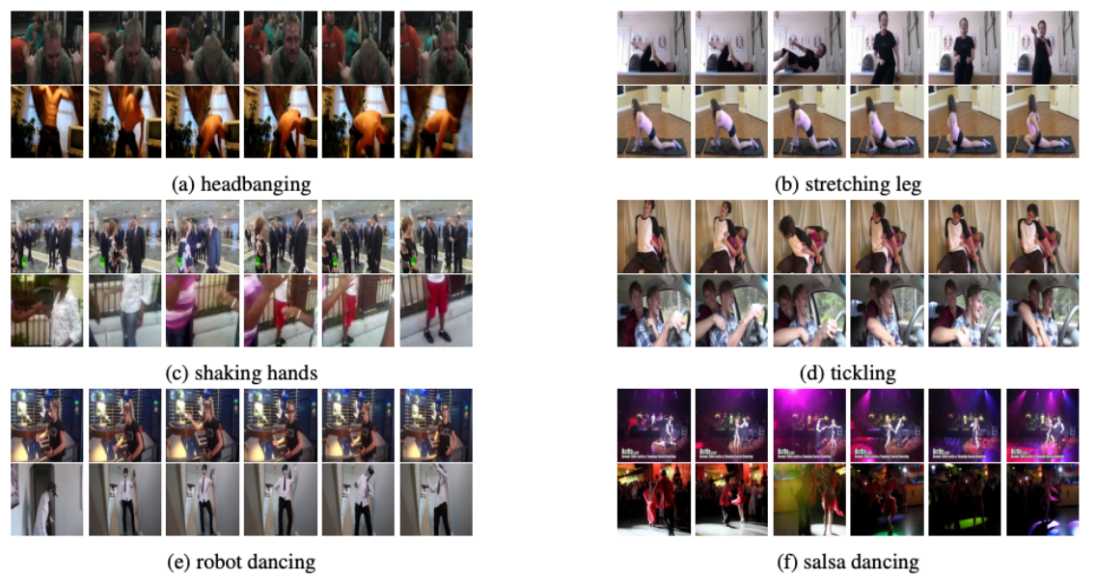
Dataset Description
Kinetics 400 – For Pedestrian State Encoder
Total Classes – 400 human actions
Each clip lasts around 10 seconds and it is taken from YouTube videos.

Slide 17
Modules
Dataset Preprocessing
Pedestrian Centric Environment Features
Pedestrian State Features
Intention Prediction Decoder

Slide 18
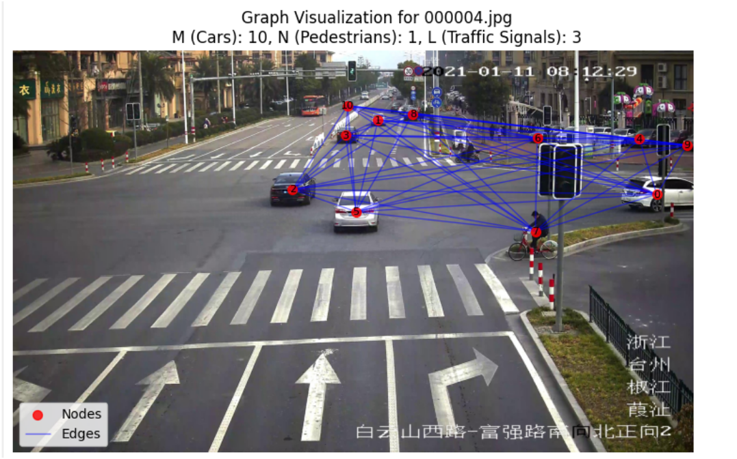
1. Data Pre Processing
Object Detection:
Model used : Pre trained YOLOV8
--Used to predict the cars and pedestrians from the scene
Graph Creation from the detected objects with weight adjacency
Matrix

Slide 19
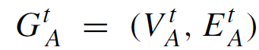
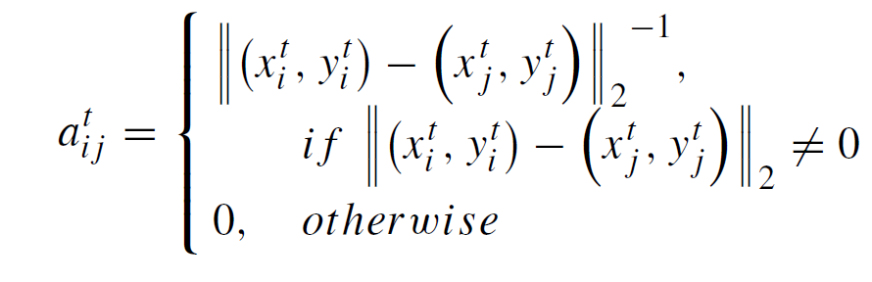
2. PEDESTRIAN CENTRIC ENVIRONMENT FEATURES
GRAPH CONVOLUTIONAL NETWORK
Input:
Set of M vehicles, N pedestrians, and L traffic signals in the scene.
Graph Data Creation :
where V is the set of nodes and E is set of edges at a time t.
Adjacency matrix Creation

Slide 20
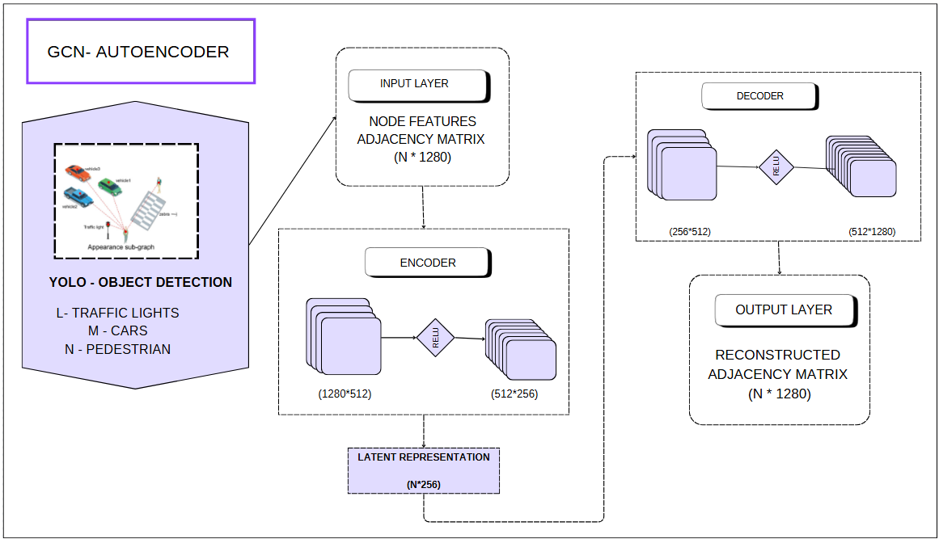
Graph Convolutional Network (Contd..)
Architecture

Slide 21
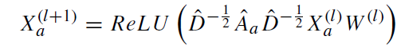
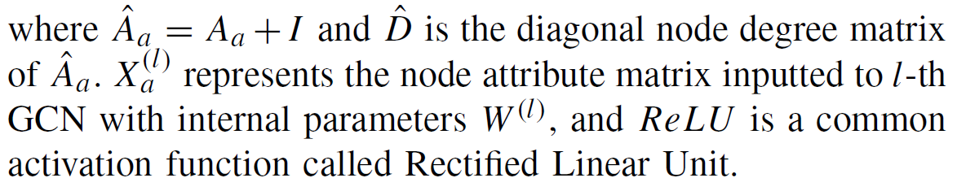
Graph Convolutional Network (Contd..)
The layer propagation of graph convolution / node embedding

Slide 22
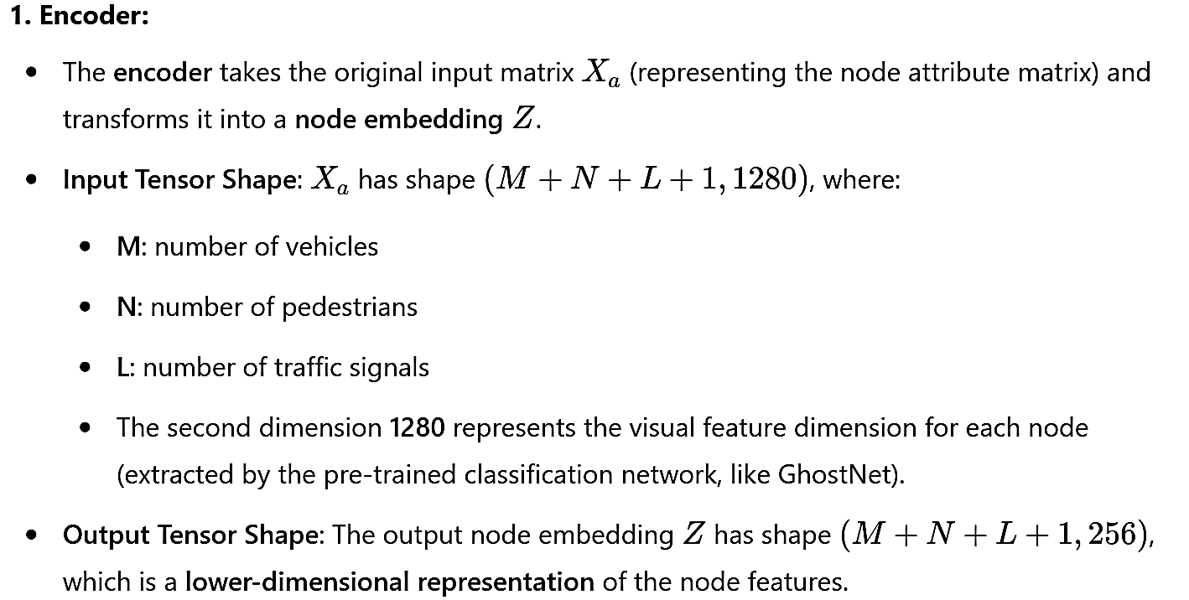
Graph Convolutional Network (Contd..)
Encoder – Decoder Architecture
Encoder

Slide 23
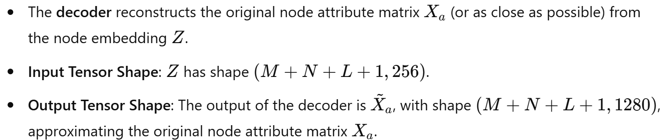
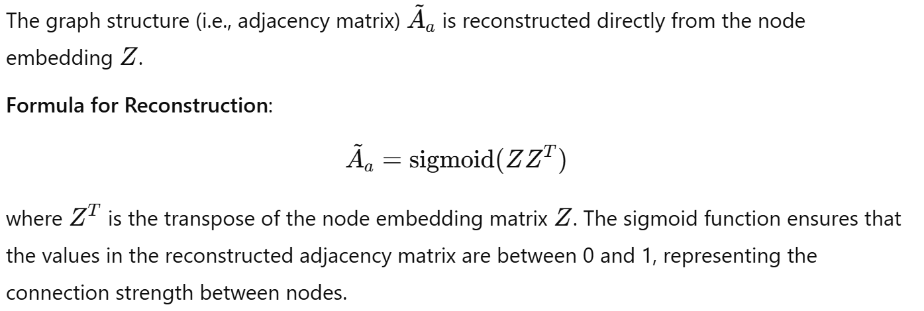
Graph Convolutional Network (Contd..)
Decoder
Reconstructed Graph

Slide 24
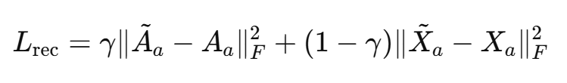
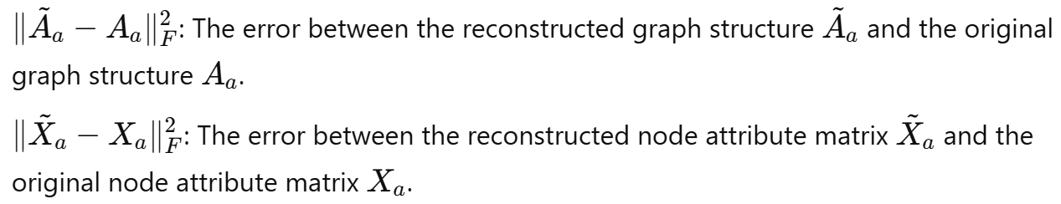
Graph Convolutional Network (Contd..)
Reconstruction Loss

Slide 25
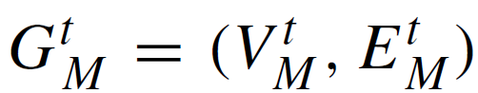
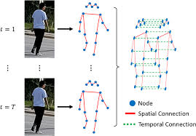
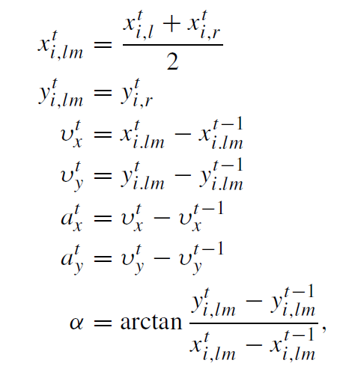
SPATIO – TEMPORAL GCN:
Input:
Set of M vehicles, N pedestrians, and Z zebra crossings in the scene.
Graph Data Creation :
Motion information

Slide 26
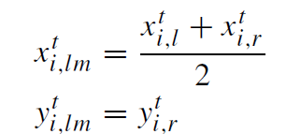
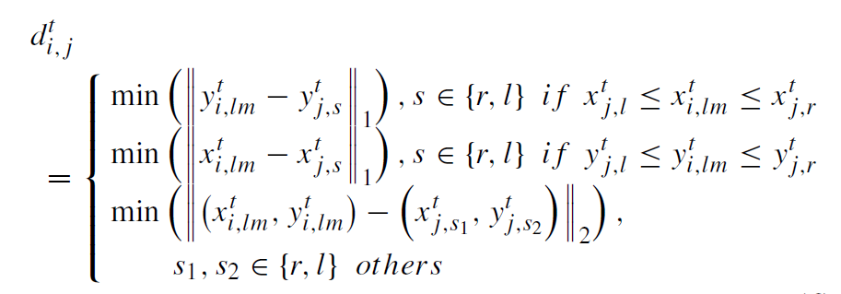
ST-GCN (Contd..)
Position information
Create weight adjacency matrix similar to GCN.

Slide 27
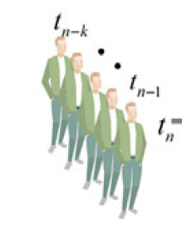
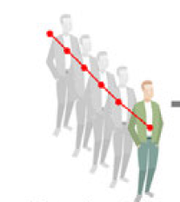
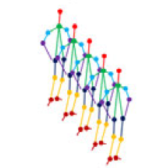
3. PEDESTRIAN STATE FEATURES
Pedestrian state encoder
Input :
Pedestrian appearances
History trajectories
Skeleton data

Slide 28
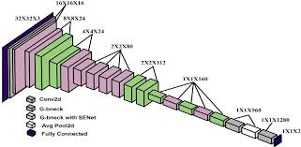
Pedestrian state encoder (contd…)
Appearance Feature Extractor :
Model : Pre-trained CNN (GhostNet)-trained on ImageNet dataset.
Features Extracted : gaze, posture, and actions

Slide 29
Layer Details
Input Layer (YOLO)
Initial Convolution Block
Ghost Module
Depthwise Separable Convolution Layers
Global Average Pooling (GAP)
Fully Connected Layer
Output

Slide 30
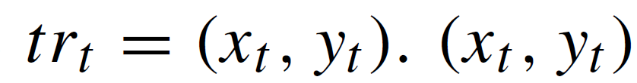
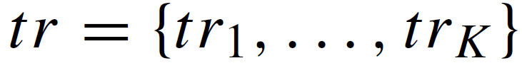
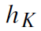
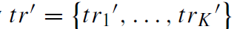
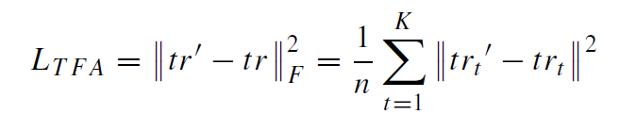
Trajectory Feature Extractor :
Model : Long Short-Term Memory (LSTM) autoencoder
Encoder :
Input : Sorted set of trajectory points
where
Decoder :
Input: Encoder’s hidden state
Output : Reconstructed Trajectory
Objective function of LSTM autoencoder

Slide 31
Layer Details
Input is a set of trajectory points: tr = {tr1, ..., trK}, where each trajectory point trt consists of pixel coordinates (xt, yt)
Encoder : Sequential LSTM layers process the trajectory points, extracting temporal features like speed and direction. Hidden states of the LSTM represent intermediate trajectory information. Output :The final hidden state of the LSTM (hK) serves as the encoded trajectory feature.
Decoder: Takes the encoded feature vector as input and reconstructs the trajectory point-by-point. Fully Connected Layer: A dense layer maps the output of the decoder back to pixel coordinates (xt, yt) for reconstruction.
Loss Function: Mean Squared Error (MSE) loss ensures the reconstructed trajectory (tr′) matches the input trajectory (tr).
Output: The encoded trajectory feature vector represents pedestrian motion characteristics like direction and velocity.

Slide 32
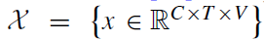
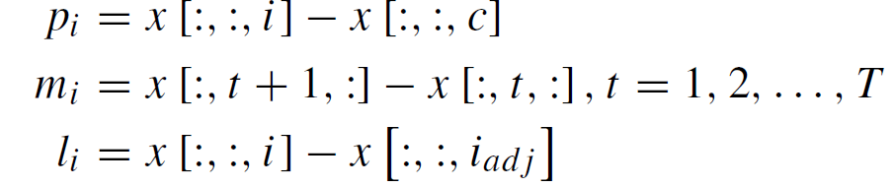
Skeleton feature extractor
Input :
Pedestrian body skeletons
Where C => Coordinate , T => Frame , V => Joint
Preprocessing steps

Slide 33
GCN-based Skeleton Feature Extractor
Batch Normalization: For fast convergence
Initial Block: For data-to-feature transformation
GCN Blocks: For informative feature extraction
Attention Module: For distinguishing informative joints and frames
Global Averaging Pooling: For feature abstraction
Fully Connected Layer: For classification output

Slide 34
Layer Details
Input Layer: Input is a sequence of skeletons, X = {x ∈ R^(C×T×V)}, where:
C = number of coordinates (e.g., 2D or 3D).
T = number of frames.
V = number of joints.
Preprocessing: Joint Positions (P) , Normalized positions of each joint relative to a central joint (e.g., spine) Motion Velocities (M): Temporal differences between joint positions in adjacent frames.Bone Features (B): Bone lengths and angles computed from adjacent joint positions.
Graph Construction: Nodes represent joints. Edges represent spatial or temporal connections between joints.
Graph Convolutional Network (GCN) BlocksLayer: Concatenates outputs of multiple branches (joint positions, motion velocities, bone features). Global Average Pooling (GAP)
Output : Skeleton feature vector encapsulating movement dynamics such as leg lifting or waving.

Slide 35
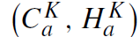
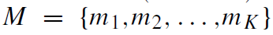
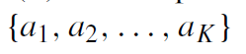
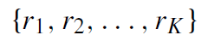
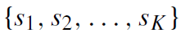
4 . Intention Prediction Decoder
Inputs:
Environment Encoder Outputs:
GCN-based autoencoder outputs
ST-GCNN outputs
Pedestrian-State Encoder Outputs:
Appearance features
Trajectory features
Skeleton features

Slide 36
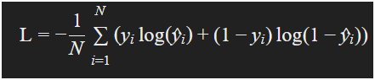
Layer Details
Input Layer: Takes feature vectors from:
Appearance Feature Extractor.[224,224,3] →[128]
Trajectory Feature Extractor. [30,2] → [128]
Skeleton Feature Extractor.[3,30,17] → [128]
Environment Encoder [variable]→ [128]
Fusion Layer: Concatenates all input features into a single unified vector.D=d1+d2+d3+d4.
Fully Connected Layers: Sequential dense layers process the unified vector, reducing its dimensionality while extracting higher-level relationships.Hi+1 =WiHi+bi
Decoder : [512] → Hidden layers [512→256→128]→ [2]
Softmax Layer: Outputs the probability of the pedestrian intending to cross the road. Loss : Cross Entropy

Slide 37
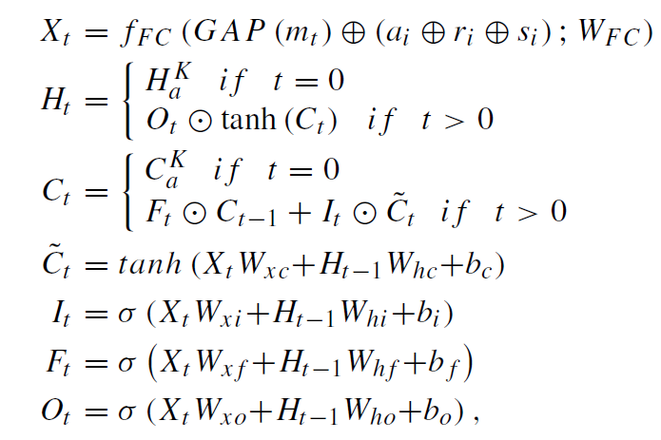
Feature Aggregation:

Slide 38
LSTM Cell Operations
Memory Cell ((C_t)): Stores information over time.
Hidden State ((H_t)): Output of the LSTM.
Gates:
Input Gate ((I_t)): Controls new information.
Forget Gate ((F_t)): Discards old information.
Output Gate ((O_t)): Outputs information.
GAP: Global Average Pooling.

Slide 39
Selection Criteria:
Positive Samples (Crossing Pedestrians):
Pedestrians with a waiting time of at least
K1+K2 seconds are considered. Those with insufficient waiting time are discarded as they do not provide a complete observation for training.
Negative Samples (Non-Crossing Pedestrians):
Pedestrians staying for less than
K1 seconds are discarded since they also lack complete sample data.

Slide 40
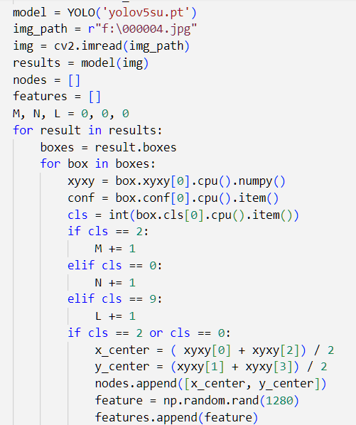
Implementation
Object Detection:

Slide 41
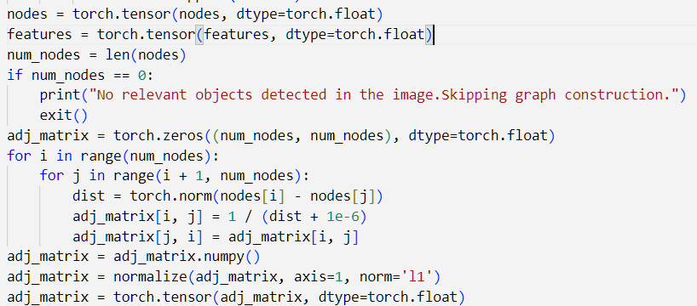
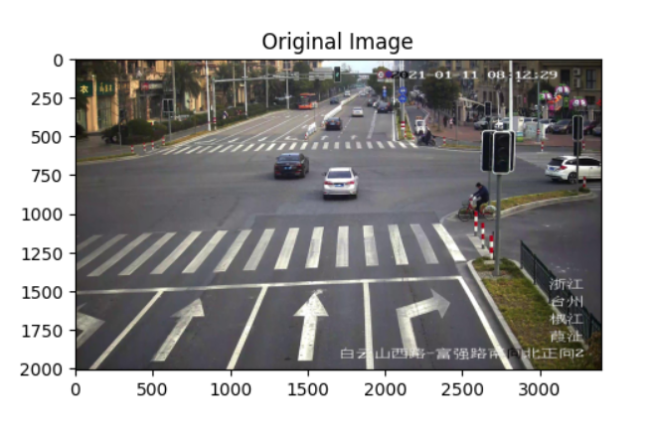

Graph and adjacency matrix creation:

Slide 42

Graph Convolutional Network :

Slide 43


Slide 44



Slide 45

Skeleton Feature Extractor

Slide 46


Skeleton Features – Result
Frames are taken by every second

Slide 47
SWOT ANALYSIS
FUTURE WORK
SOCIAL IMPACT
APPLICATION
Complexity Analysis
Time & Space Complexity

Slide 48
SWOT ANALYSIS
Strengthness
Combines deep learning, IoT, and GCN-based models for an advanced pedestrian safety solution.
Provides timely alerts to prevent accidents and improve traffic safety.
Utilizes robust models like YOLO v4, GCN, and LSTM for efficient detection and prediction with high precision.
The system can be implemented in various environments, from urban areas to highways.
Reduces the need for expensive on-vehicle sensors through a centralized IoT-based monitoring approach.

Slide 49
Weakness
Relies heavily on continuous internet connectivity for real-time operation.
Requires coordination between multiple technologies and stakeholders for deployment.
Performance may vary depending on the quality and availability of hardware components like GPUs and IoT devices.
Handling pedestrian data may raise concerns over privacy and security.

Slide 50
Oppurtunities
Aligns with global smart city initiatives, making it an attractive proposition for governments and urban planners.
Opens doors for partnerships with automobile manufacturers for ADAS and autonomous vehicle development.
Can be adapted for use in diverse regions with high pedestrian traffic and road accident rates.
Provides valuable traffic and behavior data for urban planning and policymaking.

Slide 51
Threats
Compliance with local traffic laws and privacy regulations may delay implementation.
Increasing competition from existing ADAS and IoT-based safety solutions.
Initial setup and ongoing maintenance might pose financial challenges for widespread adoption.
Adverse weather conditions (e.g., rain, fog) could affect the accuracy of detection systems.

Slide 52
Thank You

